Slide 1

Hospital Management System
Course: OOP with Java
Lecturer: Dr. NTEZIRIZA NKERABAHIZI Josbert
School: University of Kigali

Slide 2
Introduction
Project Overview: Java (Swing UI) + MySQL (phpMyAdmin)
Purpose: Simplify and automate hospital workflows
User Roles: Admin, Doctor, Nurse, Lab Technician, Pharmacist, Receptionist, Patient

Slide 3
System Features
Authentication (login by role):
The users login with their provided credentials to access their Dashboards
Role Dashboards (redirects to unique views):
These Dashboards present to them all the operations available in their roles
Full hospital workflow:
Registration → Diagnosis → Tests → Pharmacy → Treatment → Billing

Slide 4
User Dashboards
Admin: Manage staff, create accounts
Receptionist: Register patients, billing
Doctor: Consultations & prescriptions
Lab Technician: Upload test results
Pharmacist: Dispense medicine, manage inventory
Nurse: Apply treatment and log notes

Slide 5
Technology Stack
Component | Tech
Language | Java (JDK 8+)
UI Framework | Java Swing
Database | MySQL (InnoDB)
IDE | Eclipse/NetBeans
DB Tool | phpMyAdmin

Slide 6
Database Design
Show schema diagram
Mention foreign key relationships
Core tables: patients, staff, roles, users, consultations, bills, etc.

Slide 7
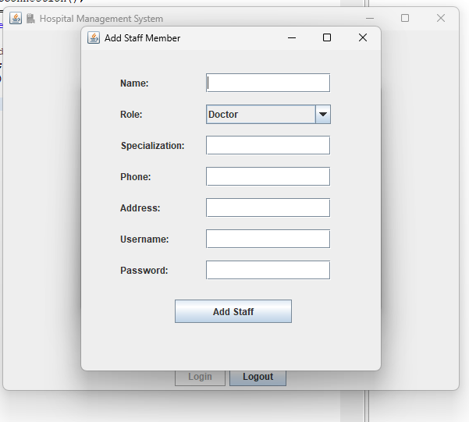
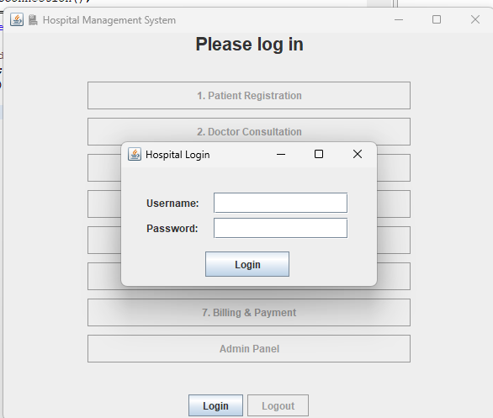
Live Demo
Login
Staff Registration

Slide 8
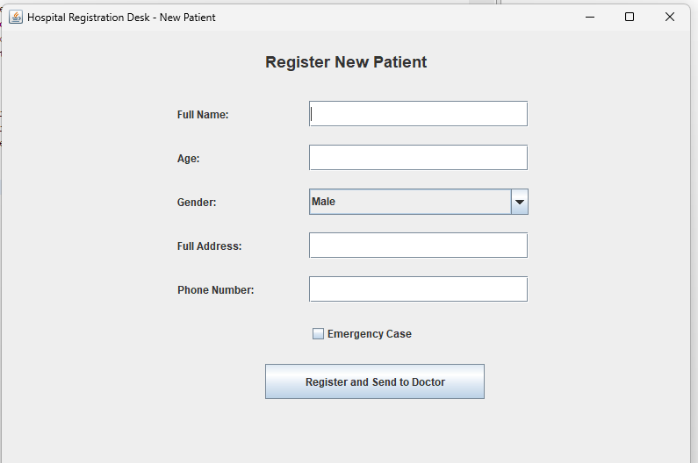
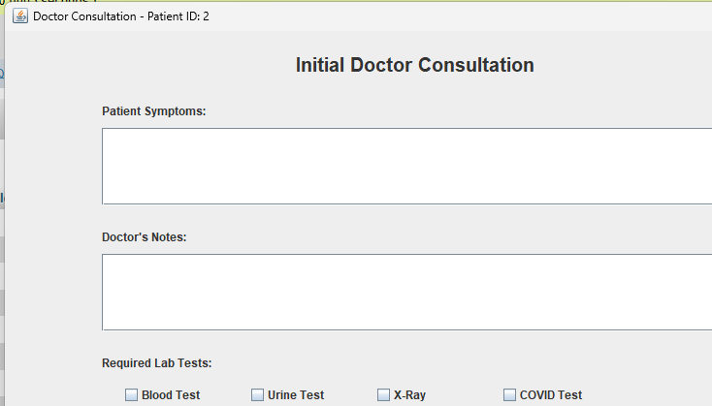
Live Demo
Reception
Doctor

Slide 9
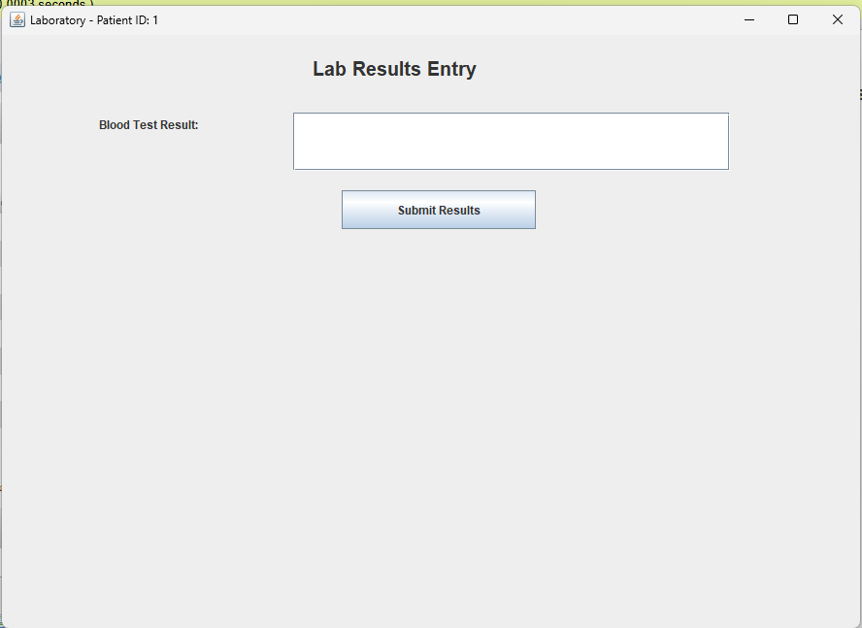
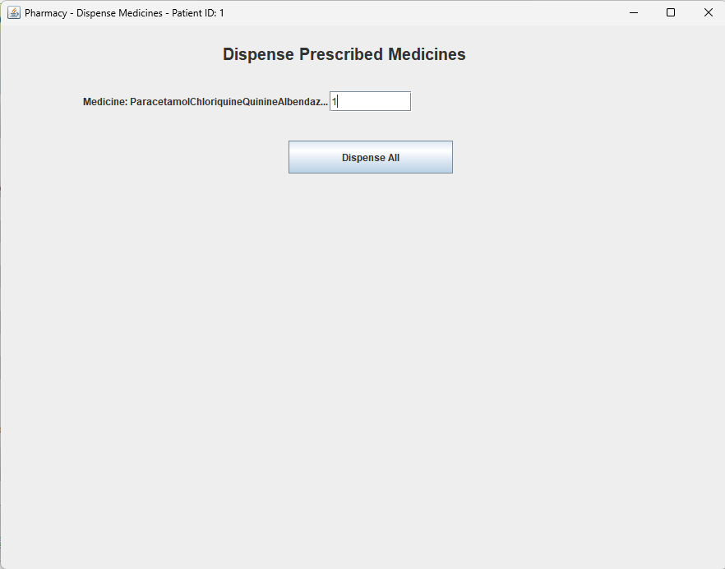
Live Demo
Lab
Pharmacy

Slide 10
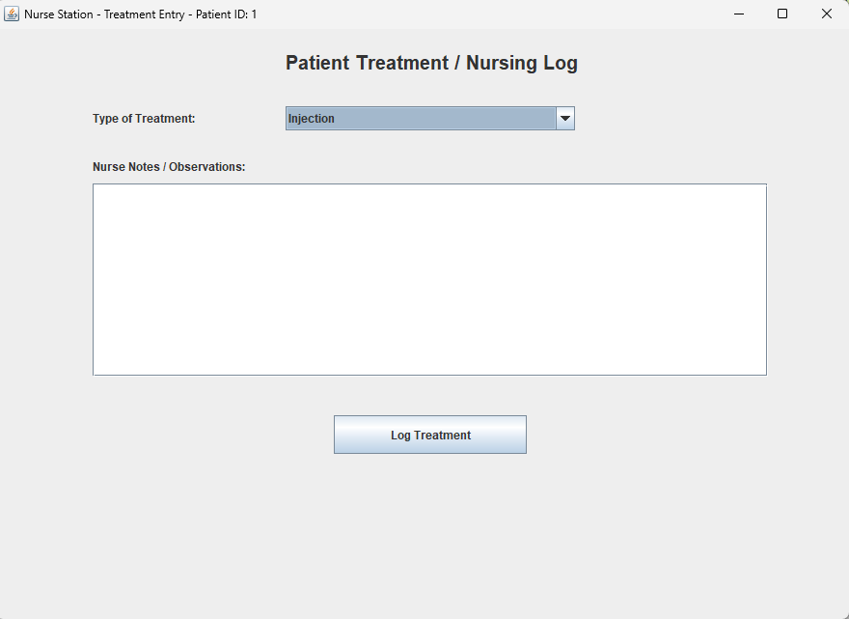
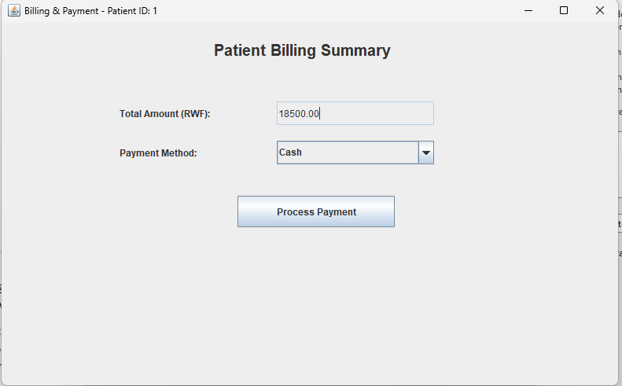
Live Demo
Nurse
Billing

Slide 11
Testing & Validation
Manual role-based testing
Input validation (empty fields check)
Error handling (try/catch, DB constraints)
Sample data used for verification

Slide 12
Challenges Faced
UI layout in Swing
Database constraint bugs
Debugging null/foreign key mismatches
Dynamic navigation between dashboards

Slide 13
Future Improvements
Password hashing:
For secure password storage
LAN deployment:
To allow different user to access the whole system online
Export reports (PDFs):
Export reports to see how the Hospital is doing
JavaFX/mobile version:
Help the Users to be able to access their dashboard anywhere and on any device
Use Hibernate ORM:
To allow to keep the user session longer and avoid unauthorized access

Slide 14
Conclusion
Summary of what the system accomplishes:
The System Is handy for managing hospitals with a big number of visits and helps with patient history storage.
Real-world simulation of hospital operations:
In War Cases, Natural Disasters and other casualties where hospitals need to process a lot of patients.
Benefits: accuracy, speed, and simplicity

Slide 15
Questions?
“Thank you for your attention. Any questions?”

Slide 16
Meet the Team
FULL NAMES | Reg Numbers
Breye Foka Lagloire | 2401000120
Emmanuel Achiengong Dutic | 2401000082
Eric Tuyishime | 2401000633
Moses Monday MALITH | 2401000974
Abdelgabar Elawad | 2401000388
MAKUR MOSES | 2309000056
IRANZI Deborah | 2309000856
Eben-Ezer Ndeingar | 2401000096
Ongiji Paul | 2401000852
Rutagarama Junior Akim | 2401000697

